Slide 1
Smart Car Parking System
Presented By
ARYANANDHA V B

Slide 2
introduction
Rapid increase in vehicle population has led to serious parking challenges in urban areas
Manual parking systems are inefficient and cause delays in locating available slots
Lack of real-time parking availability information creates confusion and wastage of time
Results in traffic congestion and highlights the need for a smart automated parking system

Slide 3
Problem Statement
Time wastage in finding a parking slot
Traffic congestion in parking areas.
Lack of real-time availability infomartion.

Slide 4
OBJECTIVE
Develop an automated parking system
Detect available slots in real-time
Display slot status to users

Slide 5
System Overview
The system is a Computer Vision–based Smart Parking System
A webcam is used to capture real-time video of the parking area
YOLO object detection model identifies vehicles in the parking zone
Detected results are processed to determine occupied and vacant parking slots
An automated gate control system manages vehicle entry based on availability
The detected parking status is updated in real-time to a web application dashboard

Slide 6
Hardware Used
ESP 8266
Servo Motor
LCD Display
Webcam

Slide 7
Software used
Python &Embedded C
PyCharm
VS Code
Anaconda
LabelImg
OpenCV
Google Colab
YOLO (You Only Look Once)
Firebase
AI Tools

Slide 8
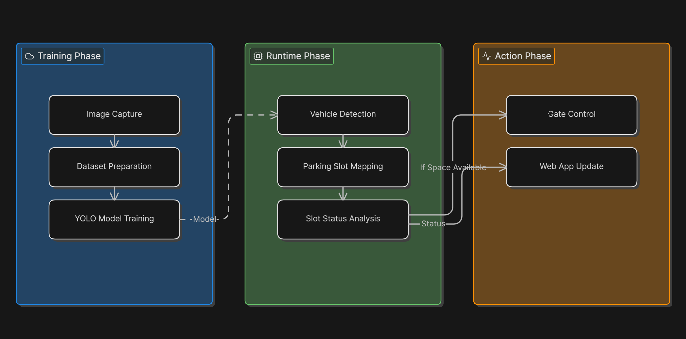
Workflow

Slide 9
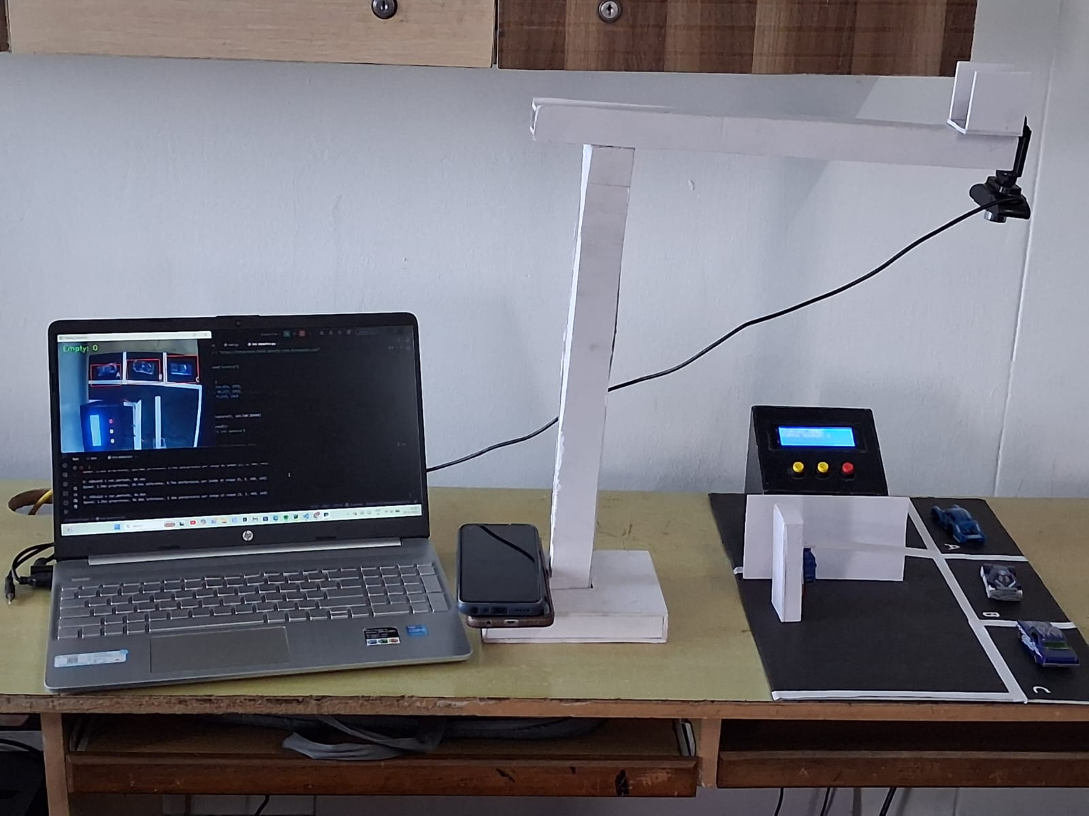
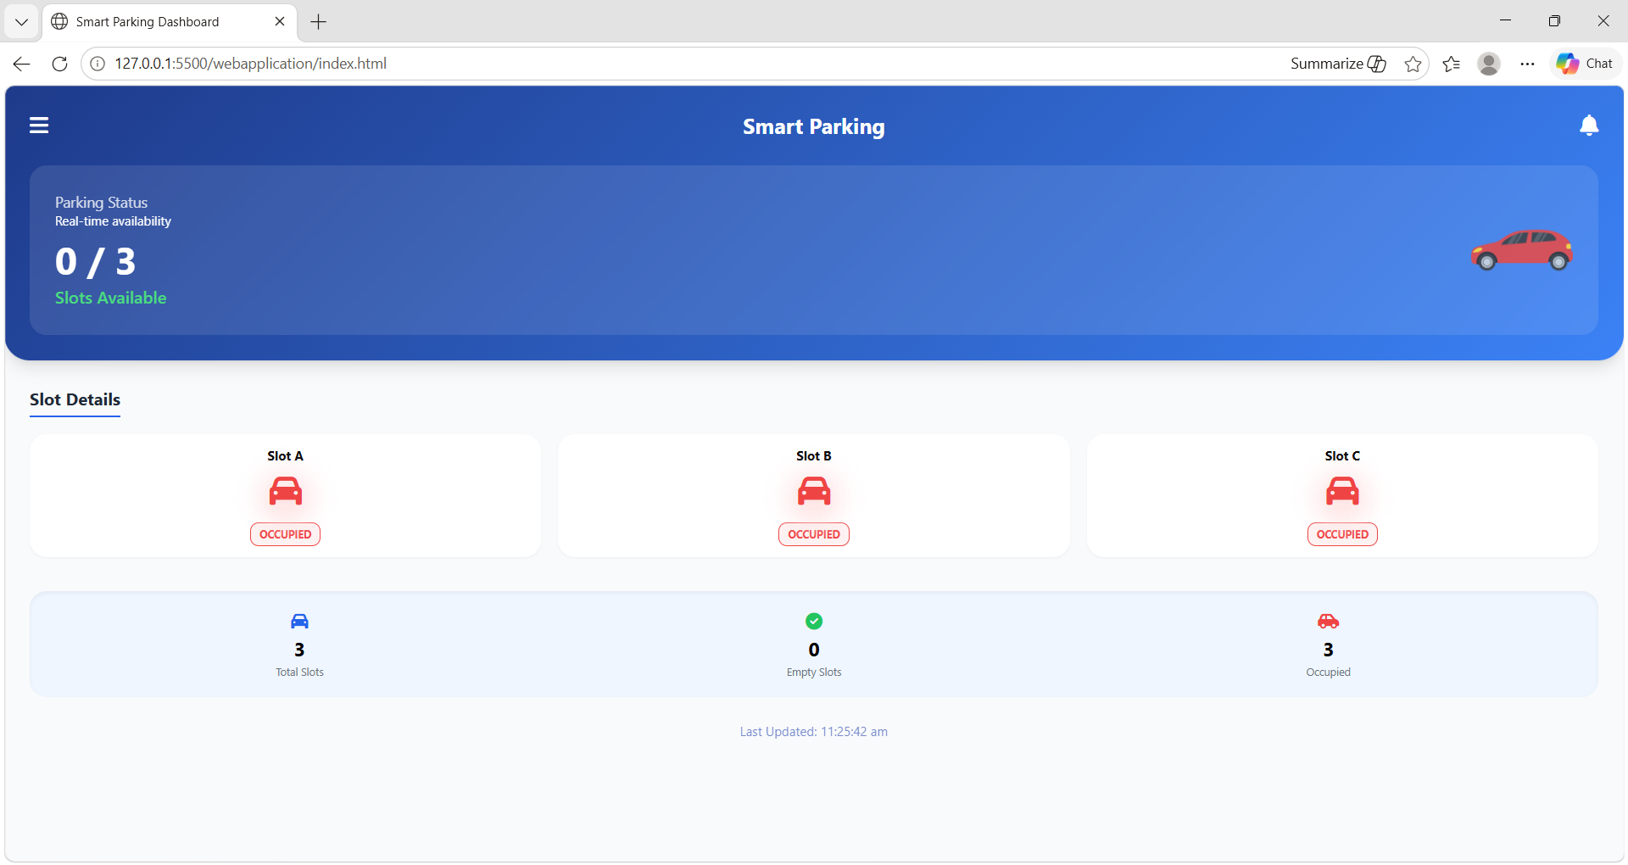
results

Slide 10
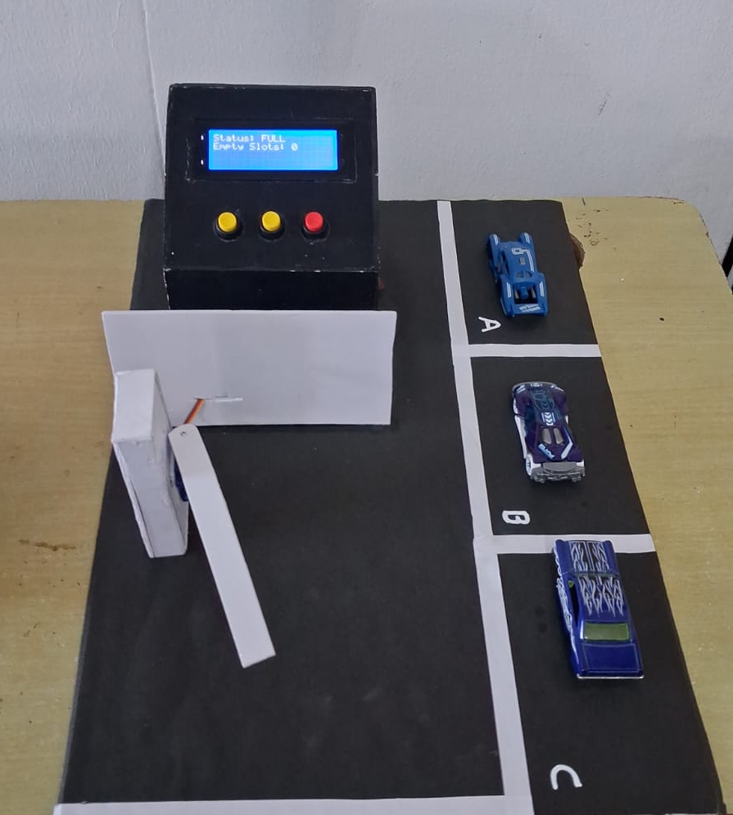
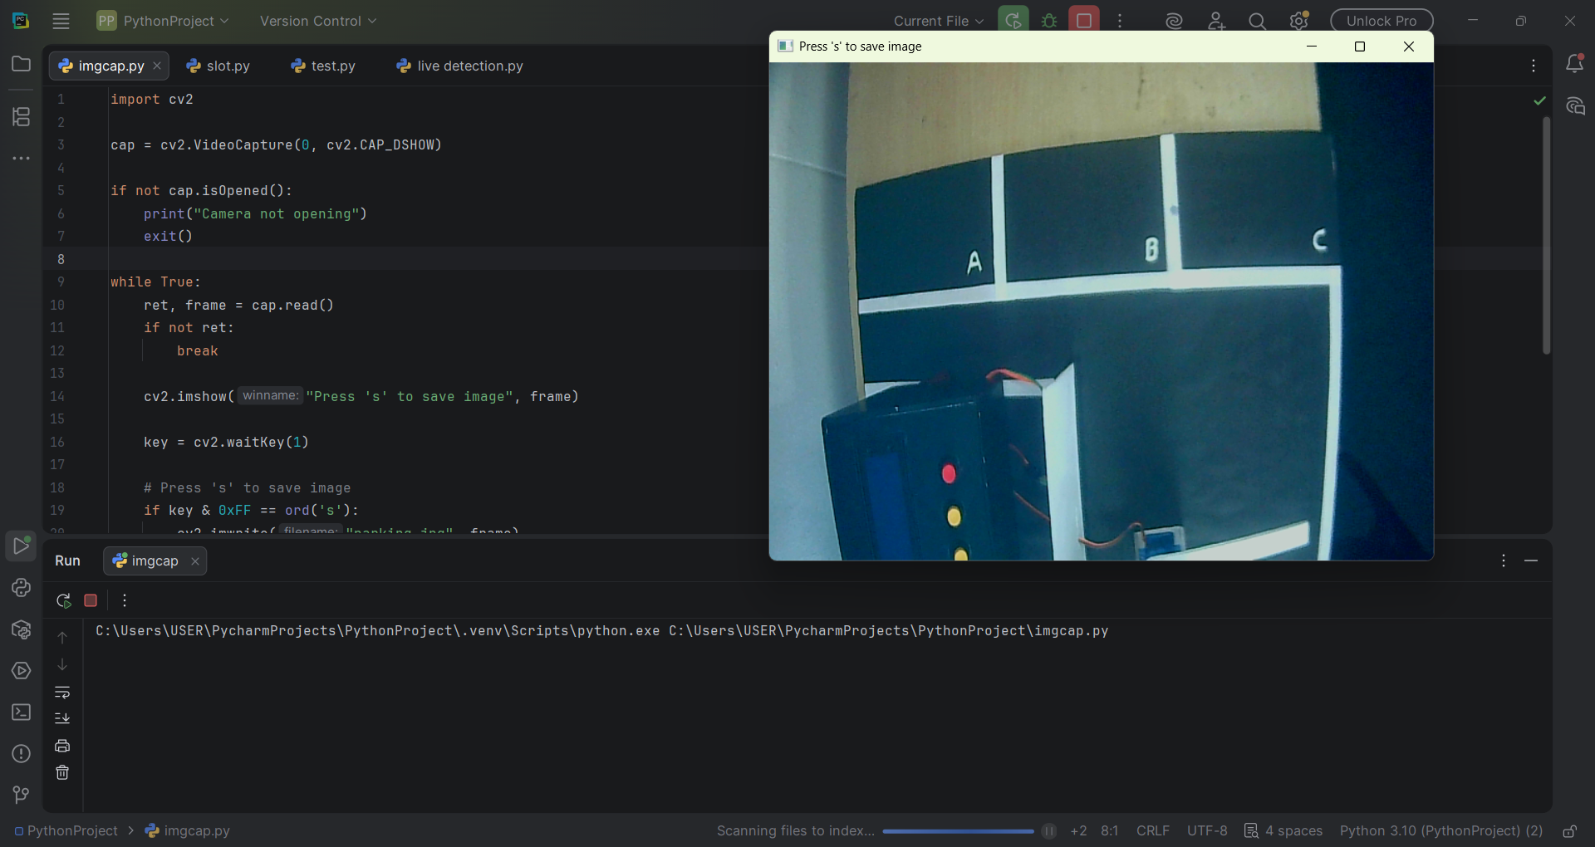

Slide 11
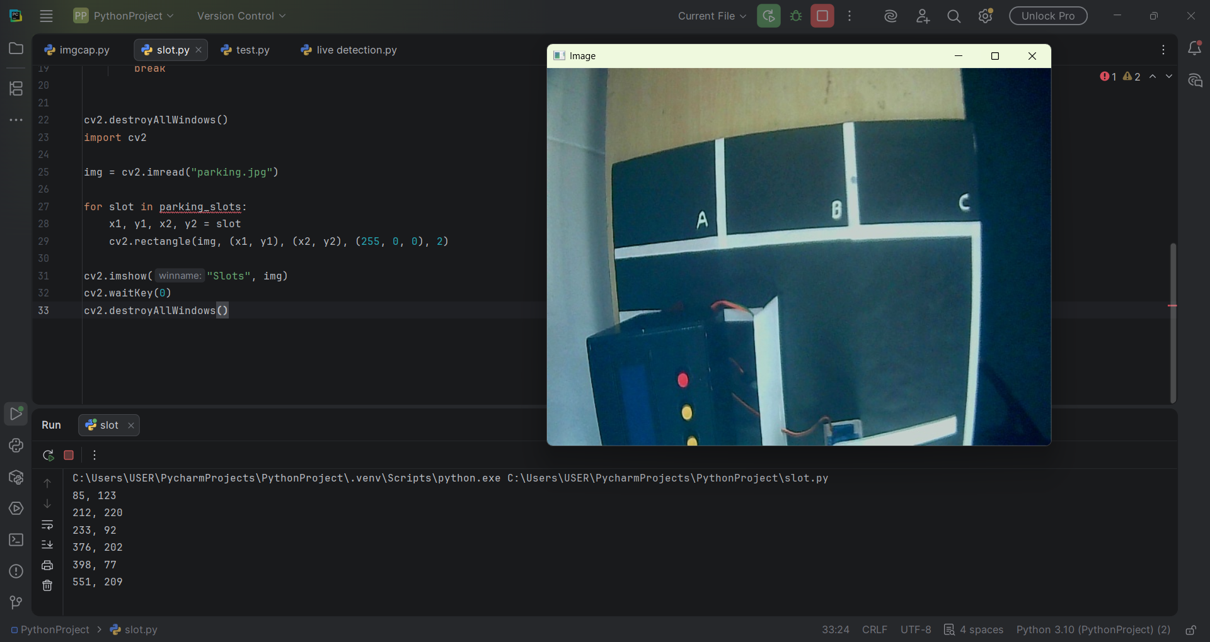
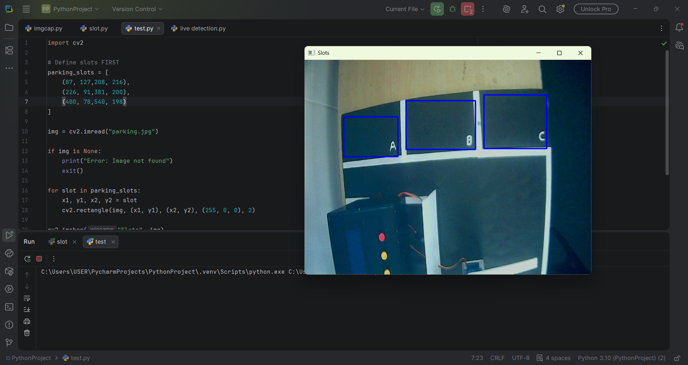

Slide 12
Advantages
Efficient Parking Space Management
Reduced Traffic Congestion in Parking Areas
Real-Time Parking Availability Monitoring
Automated and Intelligent Access Control
Reduced Human Intervention
Cost-Effective Smart Parking Solution
Scalable and Easy to Deploy
Improved User Convenience and Time Efficiency

Slide 13
Applications & Future Scope
Smart Parking Management in Shopping Malls, Hospitals, Apartments, and Smart Cities
Integration with Mobile Applications for Real-Time Parking Monitoring
AI-Based Parking Prediction and Space Optimisation
QR/RFID-Based Automated Vehicle Entry System
IoT Integration for Advanced Smart City Infrastructure

Slide 14
Conclusion
In conclusion, my project successfully demonstrates a smart parking system using AI and Computer Vision.
The system can detect parking availability in real time, automate gate control, and improve parking efficiency.
This project shows how AI can be applied in practical, real-world smart city applications.

Slide 15
Thank you

